Slide 1

CHAPTER 2: EVOLUTION OF MANAGEMENT THINKING

Slide 2
LEARNING OUTCOMES
Describe some early management examples.
Explain the various theories in the classical approach.
Discuss the development and uses of the behavioral approach.
Describe the quantitative approach.
Explain the various theories in the contemporary approach.
2

Slide 3
CONTENTS
  Historical perspectives
  Classical approach of management
  Behavioral approach
  Quantitative approach
  Contemporary approach

Slide 4
2.1 HISTORICAL PERSPECTIVES

Slide 5

Why study History of Management Theories

Slide 6
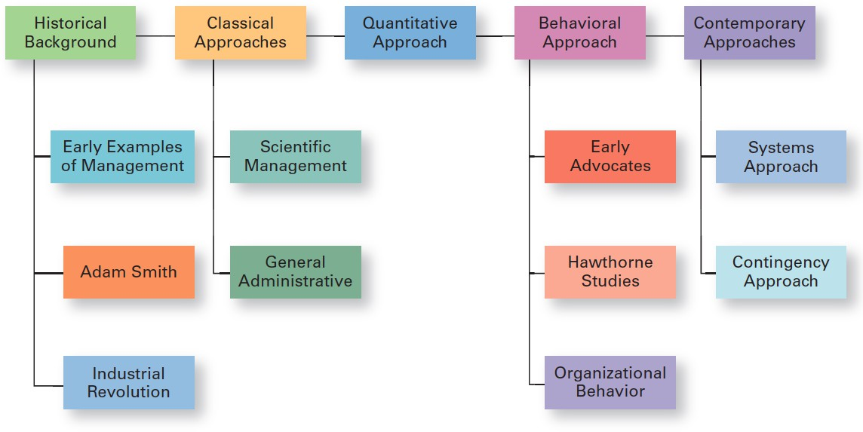
Major Approaches to Management

Slide 7
Early Management
Ancient Management – Egypt (pyramids) and China (Great Wall)
Adam Smith The Wealth of Nations in 1776
  Division of labor (job specialization) – the breakdown of jobs into narrow and repetitive tasks
Industrial Revolution
  Substituted machine power for human labor
  Created large organizations in need of management

Slide 8
Evolution of Modern Management
Began in the industrial revolution in the late 19th century as:
Managers of organizations began seeking ways to better satisfy customer needs
Large-scale mechanized manufacturing began to supplanting small-scale craft production in the ways in which goods were produced
Social problems developed in the large groups of workers employed under the factory system
Managers began to focus on increasing the efficiency of the worker-task mix

Slide 9
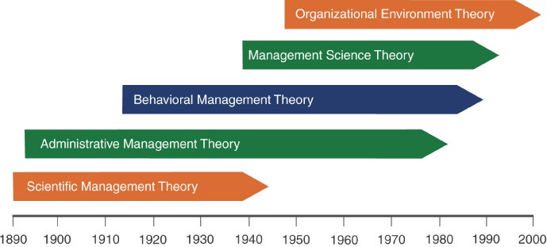
The Evolution of MGM Theory

Slide 10

2.2 CLASSICAL APPROACH OF MANAGEMENT

Slide 11
Classical Approach
Classical approach – first studies of management, which emphasized rationality and making organizations and workers as efficient as possible.
Scientific Management
General Administrative

Slide 12
Scientific Management
Scientific management – an approach that involves using the scientific method to find the “one best way” for a job to be done.
Frederick W. Taylor (1856 – 1915)
Charles Babbage (1792 – 1871)
oFrank (1868 - 1924) & Lilian Gilbreth (1878 – 1972)
oHenry L. Gantt (1861 – 1919)

Slide 13
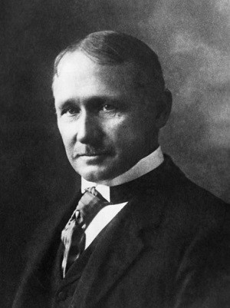
Scientific Management
Fredrick Winslow Taylor
The “father” of scientific management
Taylor sought to reduce the time a worker spent on each task by optimizing the way the task was done

Slide 14
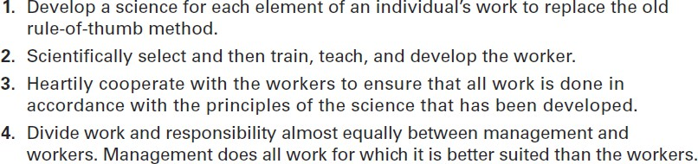
Taylor’s Scientific Management Principles

Slide 15
Problem with Taylor’s Scientific MGM Principles
Managers frequently implemented only the increased output side of Taylor’s plan.
Workers did not share in the increased output
Specialized jobs became very boring, dull. Workers ended up distrusting the Scientific Management method.
Workers could purposely “under-perform.”
Management responded with increased use of machines and conveyors belts.

Slide 16
Scientific MGM Theory_Frank and Lillian Gilbreth
Refined Taylor’s work and made many improvements to the methodologies of time and motion studies.
  Time and motion studies
  Breaking up each job action into its components.
  Finding better ways to perform the action.
  Reorganizing each job action to be more efficient.
Also studied worker-related fatigue problems caused by lighting, heating, and the design of tools and machines.

Slide 17

Issues with scientific management theory

Slide 18
General Administrative Theory
General administrative theory – an approach to management that focuses on describing what managers do and what constitutes good management practice.
oHenry Fayol (1841 – 1925)
oMax Weber (1864 – 1920)
oChester Barnard (1886 – 1961)

Slide 19
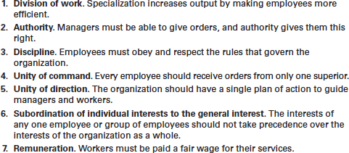
General Administrative Theory_Henri Fayol
Fayol’s 14 Principles of Management

Slide 20
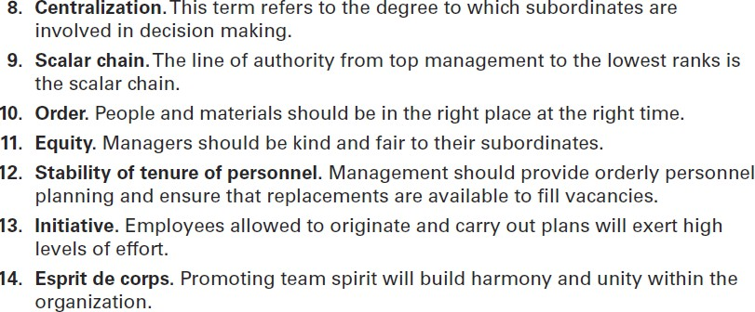
General Administrative Theory_Henri Fayol
Fayol’s 14 Principles of Management (cont.)

Slide 21
General Administrative Theory_ Max Weber
Bureaucracy – a form of organization characterized by division of labor, a clearly defined hierarchy, detailed rules and regulations, and impersonal relationships.
Weber’s Five Principles of Bureaucracy
  Authority is the power to hold people accountable for their actions.
  Positions in the firm should be held based on performance, not social contacts.
  Position duties are clearly identified so that people know
what is expected of them.
  Lines of authority should be clearly identified such that workers know who reports to who.
  Rules, standard operating procedures (SOPs), and norms guide the firm’s operations

Slide 22
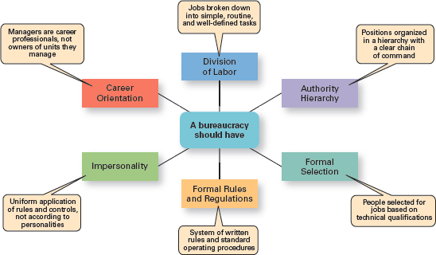
Characteristics of Weber’s Bureaucracy

Slide 23
Issues with Administration theory

Slide 24
2.3 BEHAVIORAL APPROACH

Slide 25
Behavioral Approach
Behavioral Management
The study of how managers should behave to motivate
employees and encourage them to perform at high levels and be committed to the achievement of organizational goals.
Focuses on the way a manager should personally manage to motivate employees.
oHugo Munsterberg (1863 – 1916)
oMary Parker Follett (1868 – 1933)
oDouglas Mc Gregor (1909 – 1964)
oAbraham Maslow (1908 – 1970)
oElton Mayo (1880 – 1949)

Slide 26
Behavioral Approach
Mary Parker Follett
An influential leader in early managerial theory
Held a horizontal view of power and authority in organizations
Suggested workers help in analyzing their jobs for improvements—the worker knows the best way to improve the job.
If workers have relevant knowledge of the task, then they should control the task.

Slide 27
Behavioral Approach_ The Hawthorne Studies
Hawthorne Studies – a series of studies of Elton Mayo during the 1920s and 1930s that provided new insights into individual and group behavior.
Studies of how characteristics of the work setting affected worker fatigue and performance at the Hawthorne Works of the Western Electric Company from 1924-1932.
Worker productivity was measured at various levels of light illumination.
Researchers found that regardless of whether the light levels were raised or lowered, worker
productivity increased.

Slide 28
Behavioral Approach_ The Hawthorne Studies
Human Relations Implications
Hawthorne effect—workers responded to the attention they received and were more productive.
Managers should be behaviorally trained to manage
subordinates to elicit their cooperation and increase their productivity.
Groups impose informal performance norms on their members (both “rate busters” and “chiselers”)
Gave rise to the field of Organizational Behavior

Slide 29
Issues with Behavioral Management Theory

Slide 30
2.4 QUANTITAVIE APPROACH

Slide 31
Quantitative Approach
Quantitative approach – the use of quantitative techniques to improve decision making.
Quantitative management—utilizes linear programming, modeling, simulation systems
Operations management—techniques to analyze all aspects of the production system
Total Quality Management (TQM)—focuses on improving quality throughout an organization.
Management Information Systems (MIS)— provides information about the organization.

Slide 32
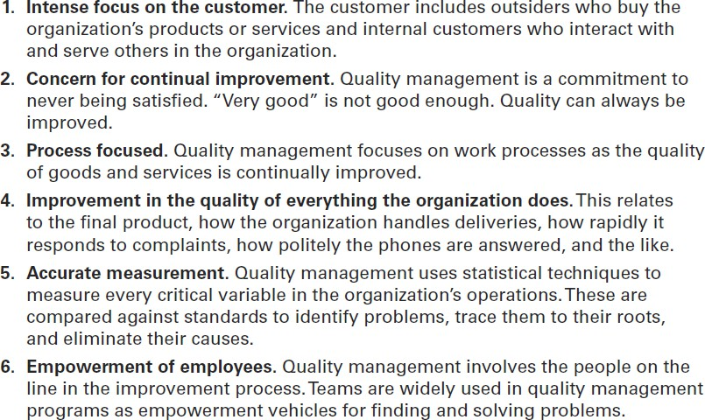
Quantitative Approach _ TQM

Slide 33
Issues with Quantitative Management Theory

Slide 34
2.5 CONTEMPORARY APPROACH

Slide 35
Contemporary Approaches
System – a set of interrelated and interdependent parts arranged in a manner that produces a unified whole.
Closed system – systems that are not influenced by and do not interact with their environment.
Open system – systems that interact with their environment.
Copyright © 2016 Pearson Educa9on, Ltd.

Slide 36
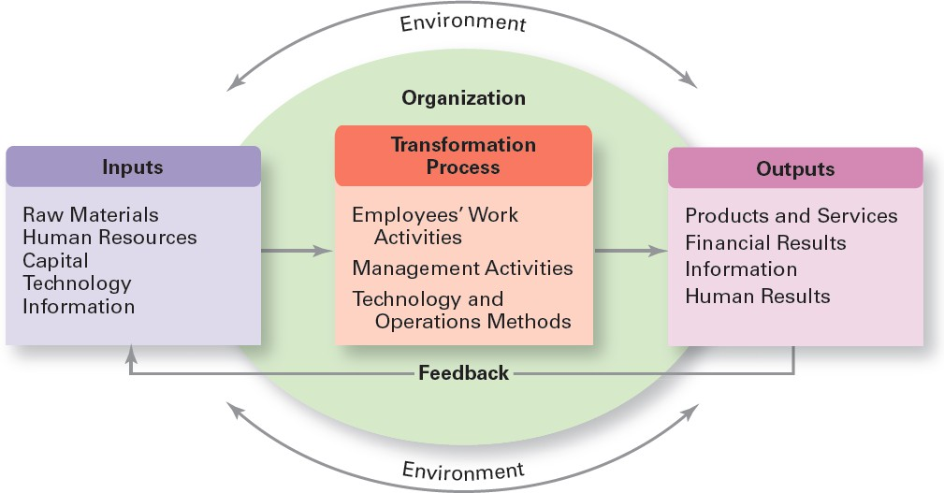
Organization as an Open System
Copyright © 2016 Pearson Educa9on, Ltd.

Slide 37
Contigency Approach
Contingency approach – a management approach that recognizes organizations as different, which means they face different situations (contingencies) and require different ways of managing.

Slide 38
Contigency Approach
The idea that the organizational structures and control systems manager choose depend on—are contingent on
—characteristics of the external environment in which the organization operates.
Assumes there is no one best way to manage.The environment impacts the firm and managers must be flexible to react to environmental changes
In rapidly changing organizational environments, managers must find ways to coordinate different departments to respond quickly and effectively.

Slide 39
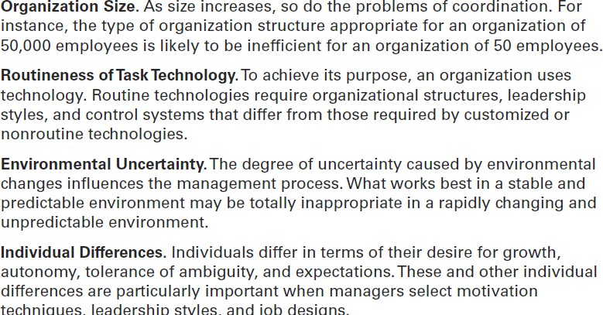
Contigency Approach
Popular Contingency Variables

Slide 40


